Slide 1
Newmarket Neighbourhood Plan

Slide 2
Introductions
Newmarket Neighbourhood Plan: led by Town Council, with advice from West Suffolk Officers
Neighbourhood Plan Working Group – mixture of councillors and residents
Writing team:
Sara Beckett
Michael Jefferys
Rachel Wood

Slide 3
What is a Neighbourhood Plan?
A chance for local people to have a say in the way their neighbourhood develops
Allows protection of green spaces
Sets priorities
Adds local detail and knowledge to broader council planning
Forms part of the Local Plan and the policies in the Neighbourhood Plan have to be considered by all developers

Slide 4
What is special about the NNP?
We wrote it ourselves
This allowed us to ensure that local voices were heard – we made a real effort to gather feedback
It saved money
It meant that we were satisfied with the result
We received a great deal of feedback which was not strictly related to planning, but rather than lose this we included ‘community actions’ alongside planning policies. These are being used to set the agenda for the Town Council.
It was sometimes very hard work, but very rewarding.

Slide 5
Timescale for revision
Writing for the original plan was completed in 2018; because of the processes involved, the plan was finally adopted in February 2020, following a successful referendum
We are now beginning revision by consulting with you and others!
We are looking for gaps in the original plan, or points where circumstances have changed
In some ways this is easier this time as we have the first NNP as a starting point – but we are open to new ideas.

Slide 6
What new areas have arisen from consultation?
Youth and Education
Biodiversity and Climate Change
Health
Food Security
New Businesses
The High Street

Slide 7
Newmarket’s relationship with its surrounding villages
Population of the Newmarket built-up area: 20,384
  - Subtracting 1,960 for Exning leaves 18,424 for the town of Newmarket; of these, 16,615 live in West Suffolk and 1,809 (c.10%) live in Cambridgeshire.
  - In addition, of 21,922 living in nearby villages, about 67% live in Cambridgeshire
  Therefore in total, 41% of the 40,346 residents living in and around Newmarket live in Cambridgeshire.

Slide 8
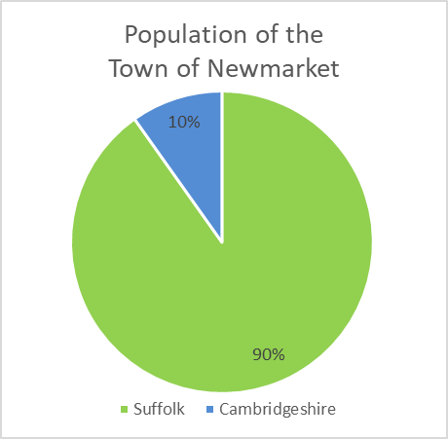
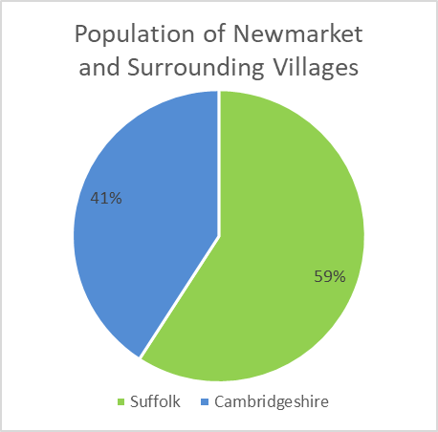
Newmarket’s relationship with its surrounding villages
Population of the Newmarket built-up area: 20,384
  - Subtracting 1,960 for Exning leaves 18,424 for the town of Newmarket; of these, 16,615 live in West Suffolk and 1,809 (c.10%) live in Cambridgeshire.
  - In addition, of 21,922 living in nearby villages, about 67% live in Cambridgeshire
  Therefore in total, 41% of the 40,346 residents living in and around Newmarket live in Cambridgeshire.
  (2011 Census)

Slide 9
Newmarket’s relationship with its surrounding villages
Population of the Newmarket built-up area: 20,384
  - Subtracting 1,960 for Exning leaves 18,424 for the town of Newmarket; of these, 16,615 live in West Suffolk and 1,809 (c.10%) live in Cambridgeshire.
  - In addition, of 21,922 living in nearby villages, about 67% live in Cambridgeshire
  Therefore in total, 41% of the 40,346 residents living in and around Newmarket live in Cambridgeshire.
Shared history

Slide 10
Newmarket’s relationship with its surrounding villages
Population of the Newmarket built-up area: 20,384
  - Subtracting 1,960 for Exning leaves 18,424 for the town of Newmarket; of these, 16,615 live in West Suffolk and 1,809 (c.10%) live in Cambridgeshire.
  - In addition, of 21,922 living in nearby villages, about 67% live in Cambridgeshire
  Therefore in total, 41% of the 40,346 residents living in and around Newmarket live in Cambridgeshire.
Shared history
- Local people have always moved back and forth between Newmarket and the surrounding villages, and
the history of both settlements are intertwined

Slide 11
Newmarket’s relationship with its surrounding villages
Population of the Newmarket built-up area: 20,384
  - Subtracting 1,960 for Exning leaves 18,424 for the town of Newmarket; of these, 16,615 live in West Suffolk and 1,809 (c.10%) live in Cambridgeshire.
  - In addition, of 21,922 living in nearby villages, about 67% live in Cambridgeshire
  Therefore in total, 41% of the 40,346 residents living in and around Newmarket live in Cambridgeshire.
Shared history
- Local people have always moved back and forth between Newmarket and the surrounding villages, and
the history of both settlements are intertwined
For example, there is a record of a land transfer dated 1418, between John Langham of Nouomercat, John Northfolke and Robert Scherborne of Chepynham; and John Landwrathe, Walter Berd, Richard Skerpere and Thomas Ouyreyze, all of Multon.

Slide 12
Newmarket’s relationship with its surrounding villages
Population of the Newmarket built-up area: 20,384
  - Subtracting 1,960 for Exning leaves 18,424 for the town of Newmarket; of these, 16,615 live in West Suffolk and 1,809 (c.10%) live in Cambridgeshire.
  - In addition, of 21,922 living in nearby villages, about 67% live in Cambridgeshire
  Therefore in total, 41% of the 40,346 residents living in and around Newmarket live in Cambridgeshire.
Shared history
Shared landscape and wildlife
  8.9 We are fortunate to be surrounded by a unique landscape. The status of the Devil’s Dyke as a ‘Special Area of Conservation’ [SAC] and Site of Special Scientific Interest [SSSI], and the training grounds maintained by Jockey Club Estates (including Newmarket Heath SSSI and Newmarket Heath County Wildlife Site [CWS]) have created habitats for a diversity of wildlife, including some protected species. It is important, however, that we remember that our administrative boundaries mean nothing to wildlife; for wild creatures, our town forms an obstacle preventing their easy passage from one area of chalk grassland to another. Just to the east of our Plan Area are Bury Hill SSSI, the Limekilns CWS, Warren Hill CWS and Side Hill CWS; Snailwell Meadows SSSI, Snailwell Grasslands and Woods CWS and Old Rectory Meadows CWS lie a little further to the north, while the Devil’s Dyke SSSI extends north west to Reach and south east to Woodditton, and a strip of Newmarket Heath SSSI extends westward beyond the Devil’s Dyke, with Beacon Course Green Lane CWS, July Course Grasslands CWS and Links Golf Course CWS.
Shared issues and concerns
We are stronger if we understand and support each other
The issue of administrative boundaries only serves to slow down positive action

Slide 13
What the first NNP said about neighbouring villages
3.9 “… It is therefore of vital importance to understand not only the needs of the residents of the three West Suffolk wards at the heart of the town, but also the needs of the residents of the town who live in East Cambridgeshire, the residents of the Suffolk villages to the north and east, and the residents of the surrounding East Cambridgeshire villages. This means that planning to ensure that the town has the required level of infrastructure and services will continue to be particularly complex.”
7.4 Newmarket Community Hospital: a plan to develop it “into a health and well-being hub for the town and surrounding villages.”
10.10 The Weatherby Rail Crossing is an important pedestrian and cycle link for the town and should be part of a network of attractive, clearly signed pedestrian and cycle loops throughout the town. By establishing and maintaining such a network, connectivity within the town and to the surrounding villages will be promoted.
11.10 Newmarket has a compact shopping area and an abundance of small traditional shop units clustered around the High Street and the Guineas Shopping Centre. The Guineas is particularly important to the town because it provides a significant amount of retail floor space, meeting the requirements not only of the town but also of the surrounding villages, in East Cambridgeshire as well as in West Suffolk.

Slide 14
Over to you….
Any questions?
What would you like to see in our NP, with respect to Moulton?
What are the key issues in Moulton?
Which services in Newmarket do your residents rely on?
How do you see the relationship between Moulton and Newmarket in 20 years’ time?

Slide 15
Thank you for allowing us to attend this evening and sharing your thoughts…

