Slide 1
Land East of School Road, Moulton
Moulton Parish Council
11th July 2022

Slide 2
Overview
Strutt and Parker have been appointed by Godolphin Management Company to promote the site at Land East of School Road, Moulton as part of the emerging West Suffolk Local Plan.
We are here today to have what we hope is the first of the number of meetings with the Parish Council and we are committed to engagement on the proposals moving forward.
The proposals are at a very early stage and it is intended to continue to promote the site as part of the emerging Local Plan.

Slide 3
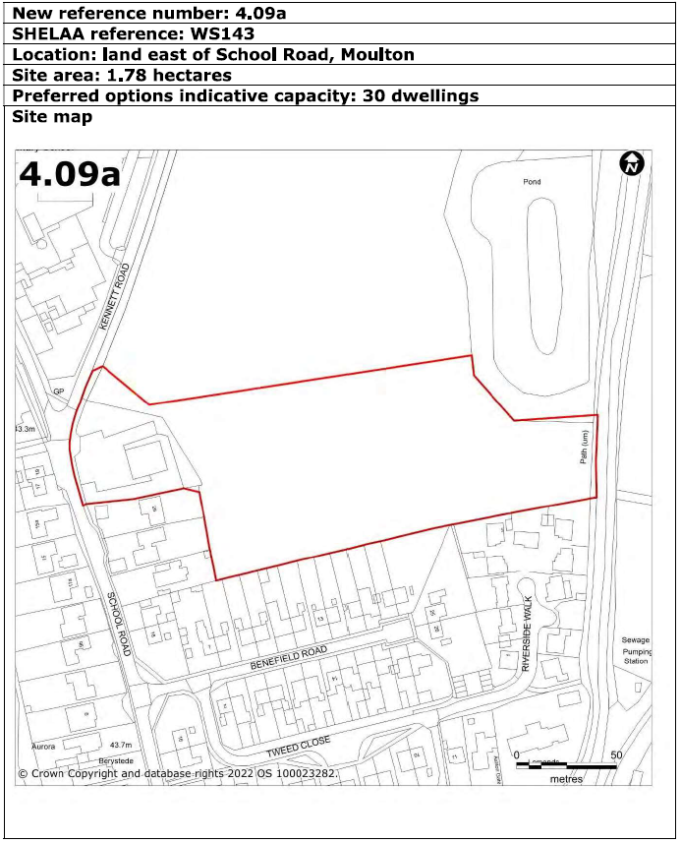
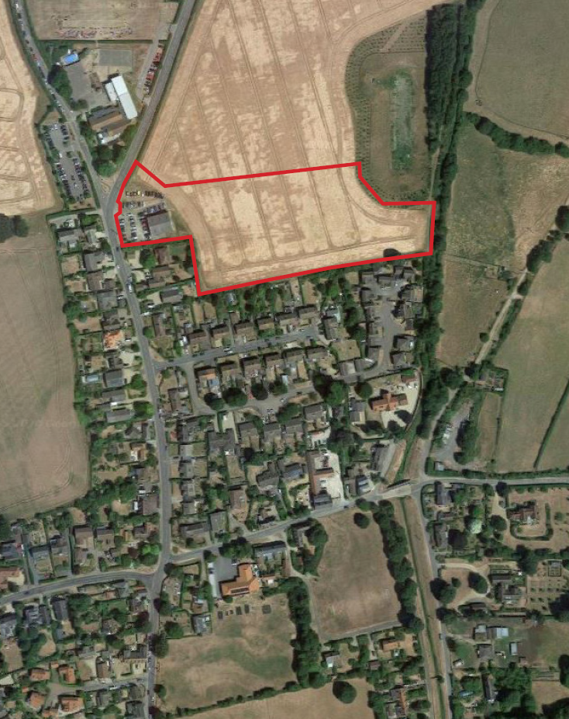
The Site

Slide 4
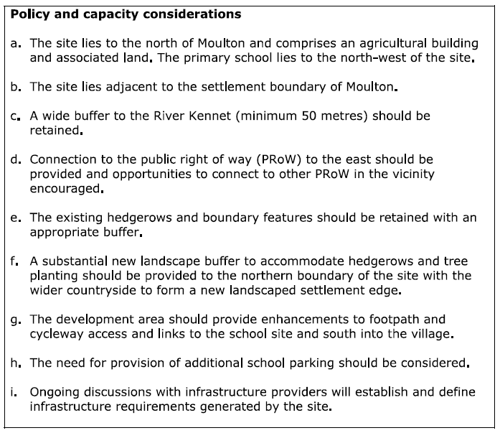
Proposed Policy Requirements for the Site

Slide 5
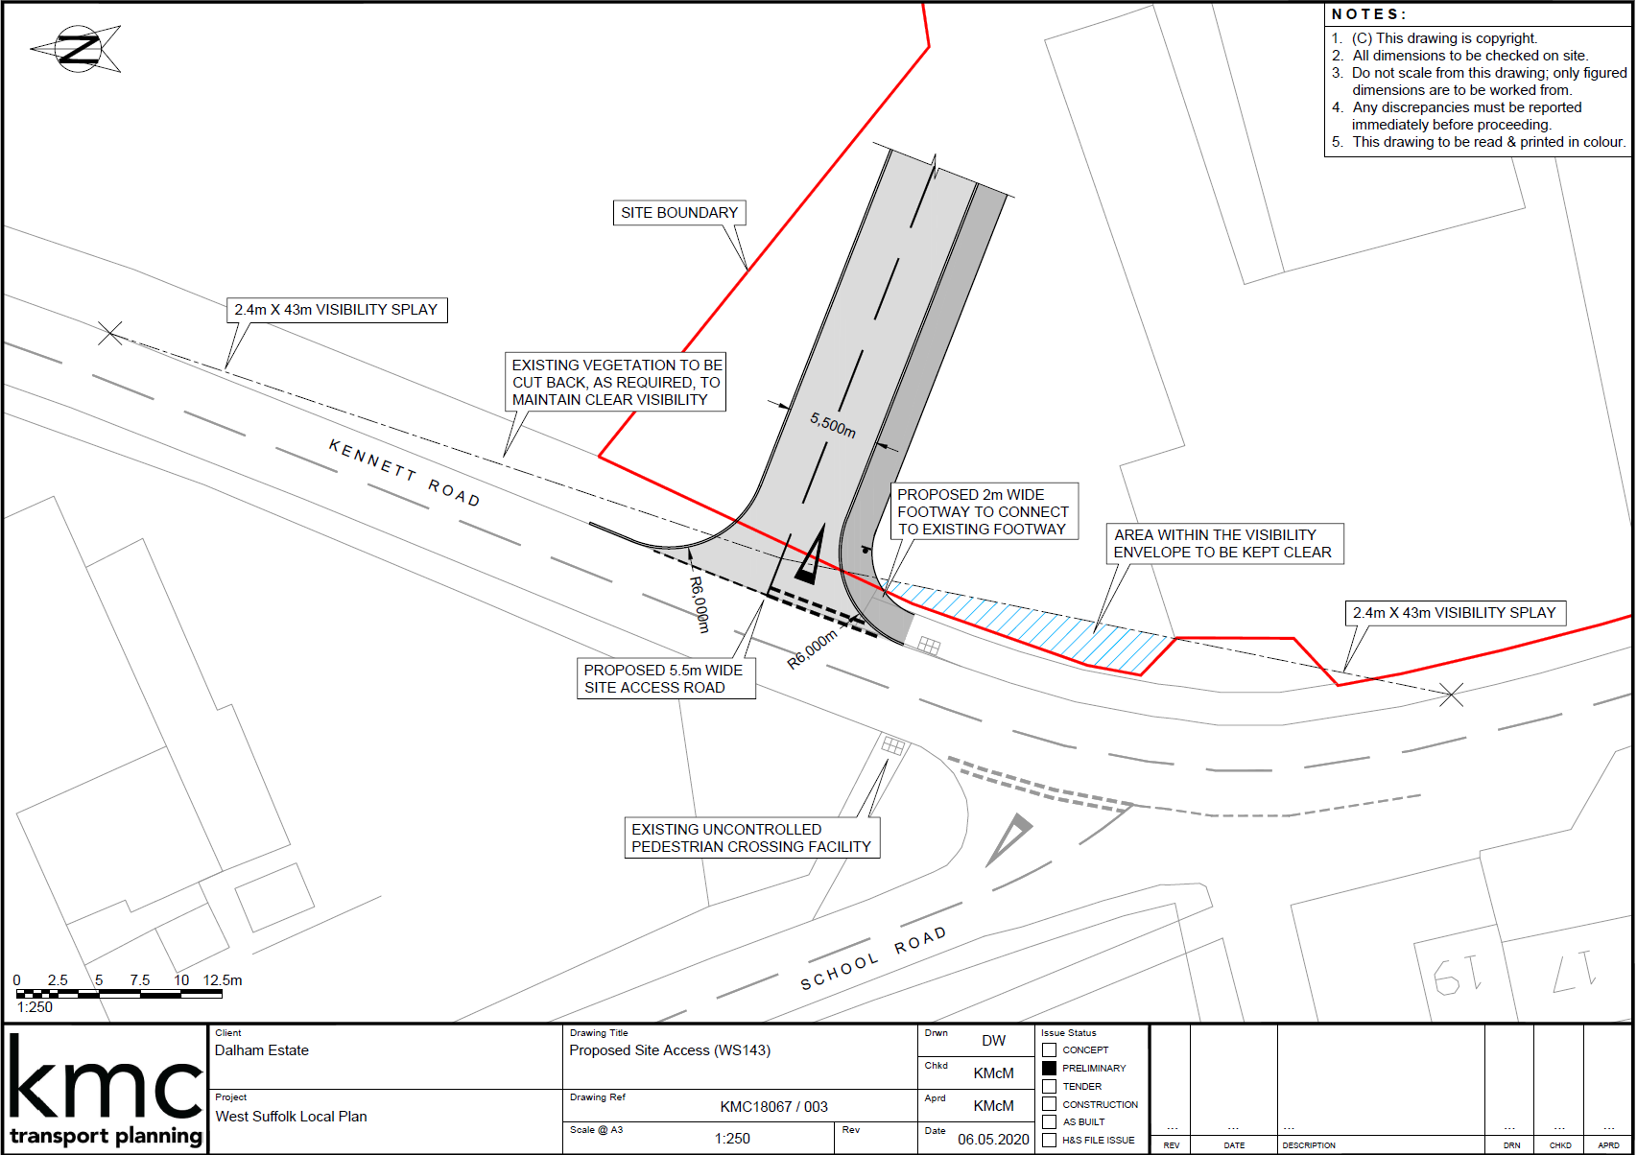
Proposed Access Location

Slide 6
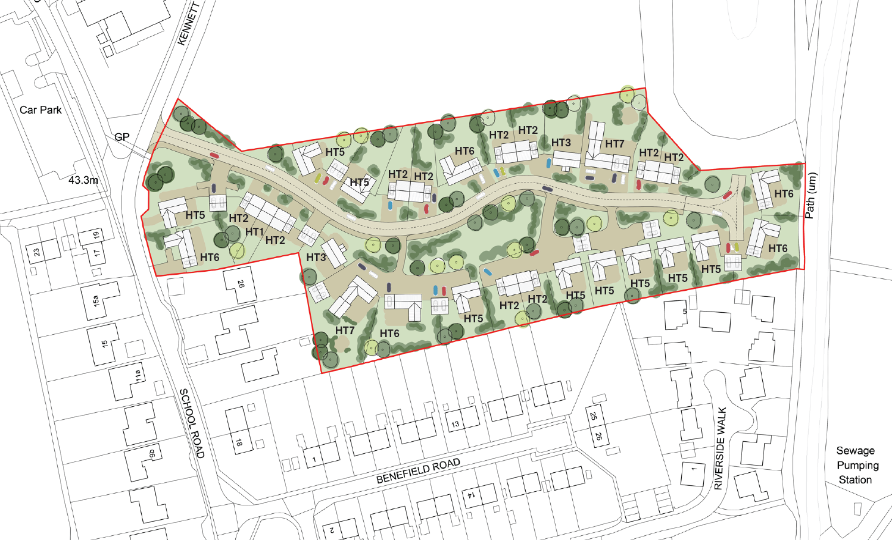
Illustrative Site Plan

Slide 7
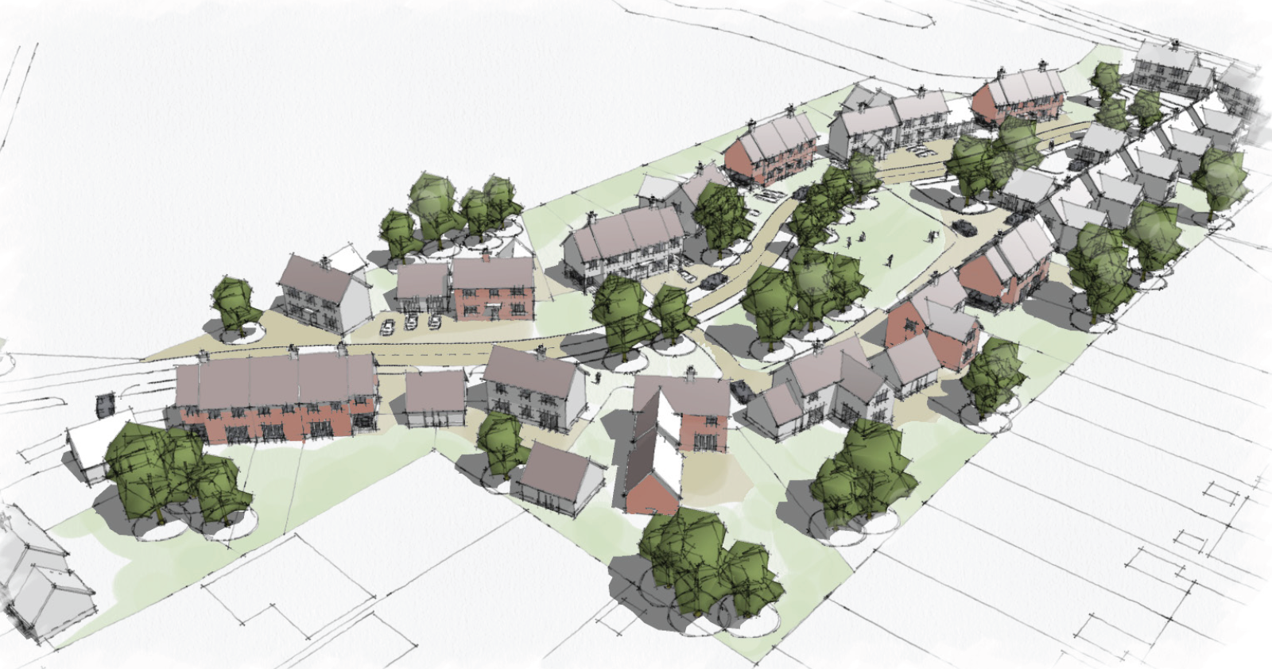
Illustrative 3G Image of Proposed Layout

Slide 8
Questions
and
Feedback

