Slide 1
West Suffolk Council Local Plan
Preferred Options Consultation

Slide 2
What is the West Suffolk Local Plan?
A local plan sets out a strategy for growth and development of an area and policies which set out the way that this plan aims to meet the housing, employment, social and community needs of an area while at the same time protecting and enhancing the natural, built and historic environment.
Balancing growth and development with protecting and enhancing the environment is often referred to as sustainable development.
It is a statutory requirement that local authorities produce a local plan for their area and keep it up to date.

Slide 3
The West Suffolk Local Plan has been divided into three parts:
Part one – Strategic policies. These set out West Suffolk Council's development strategy establishing their commitment to achieving net zero, adapting to and mitigating for climate change, setting the pattern, scale and quality of development to meet the need in West Suffolk to 2040, and making provision for all types of development, infrastructure, community facilities and the conservation and enhancement of the natural and built environment.
Part two – Non- strategic policies (these are the policies which will be used in day-to-day decision making.)
Part three – Site allocations. This document sets out the preferred site allocations. They include residential, mixed use and employment allocations.

Slide 4
How many homes are required in West Suffolk?
15,200 homes are needed for the period 2022 – 2040.
There is already planning permission for 8,600 homes.
6,600 homes need to be identified in the Local Plan.

Slide 5
How will this be achieved?
Towns – 4,913 homes
Key Service Centres – 1,384
Local Service Centres – 741
Type A villages - 96

Slide 6
What category is Moulton?
Moulton has been classed as a Local Service Centre in the Local Plan
Other local service centres:
Barningham, Beck Row, Cavendish, Exning, Great and Little Whelnetham, Great Barton, Hopton, Hundon, Rougham, West Row and Wickhambrook.

Slide 7
How many sites have been allocated for development in Moulton?
One site has been allocated for residential development in Moulton with an indicative capacity of 30 homes.
Another site has been allocated for the expansion of Moulton Primary School.

Slide 8
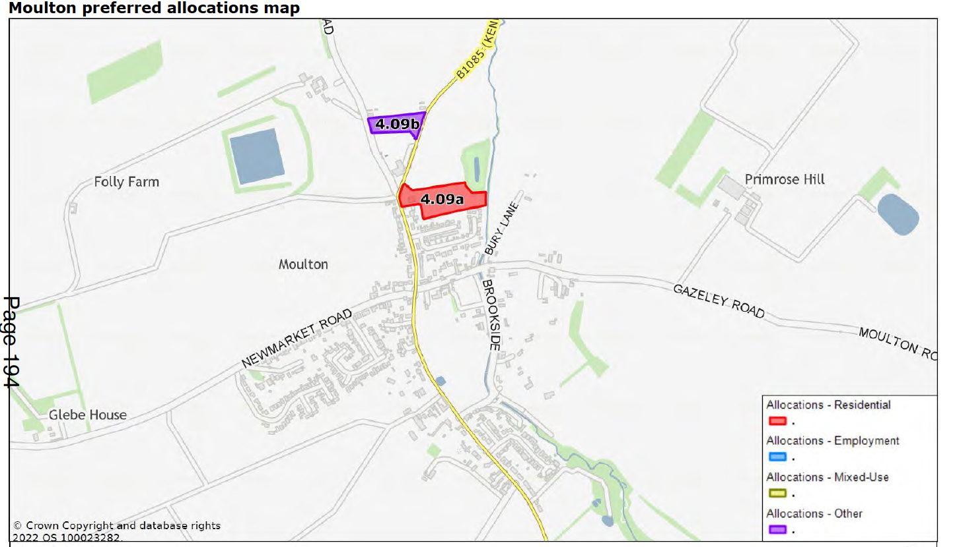

Slide 9
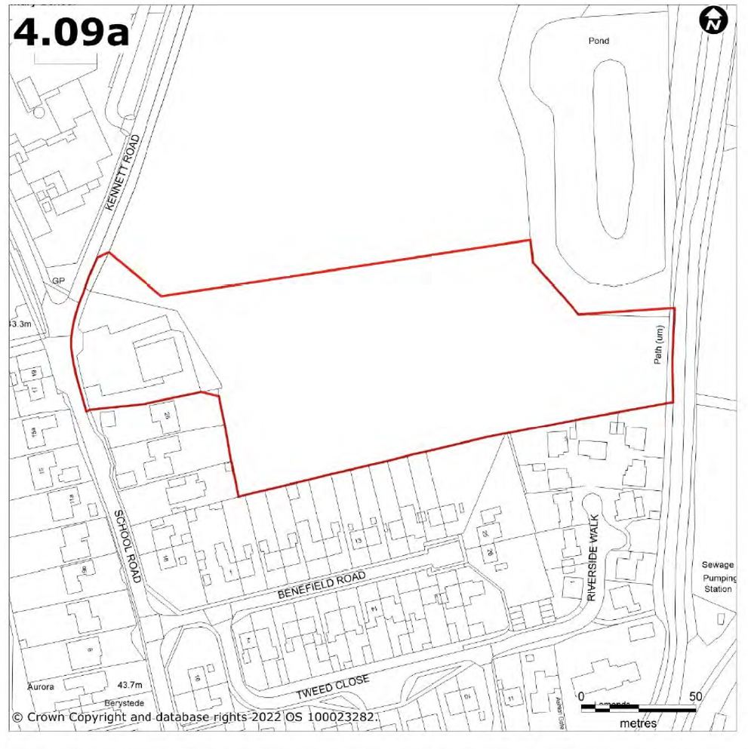

Slide 10
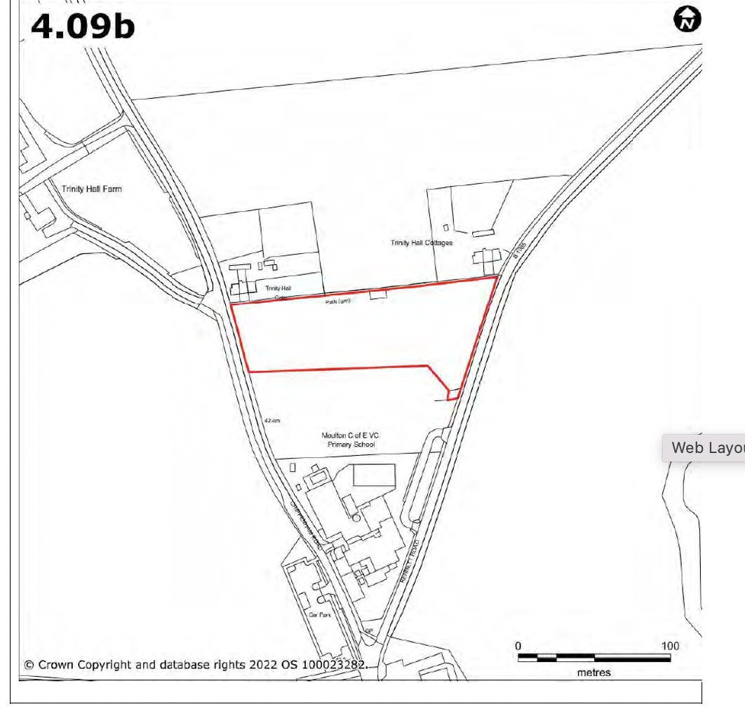

Slide 11
Omission sites
Two sites have been discounted in Moulton (omission sites). One off Newmarket Road and one off Dalham Road.

Slide 12
Next steps
The Local Plan sets out policy parameters, NOT final policies.
No firm decisions have been made on whether the sites in the document will be taken forward to the final consultation draft of the local plan.
West Suffolk Council is seeking views at this stage to assist them with making these decisions.

Slide 13
Questions:
Part one
Do you agree with the categorisation of Moulton as a Local Service Centre?
Part two
Has West Suffolk Council identified the correct new development management policies?
Is anything missing?
Part three
What are your thoughts on the sites allocated for development in Moulton?

Slide 14
How to respond to the consultation
It is important that individual responses are submitted.
The consultation period runs from 26th May 2022 to 26th July 2022.
The best way to comment on the Local Plan is online via the Council’s consultation system https://westsuffolk.inconsult.uk/consult.ti/system/listConsultations?type=all
You can also email planning.policy@westsuffolk.gov.uk with any queries or ring 01284 757368.

