Slide 1
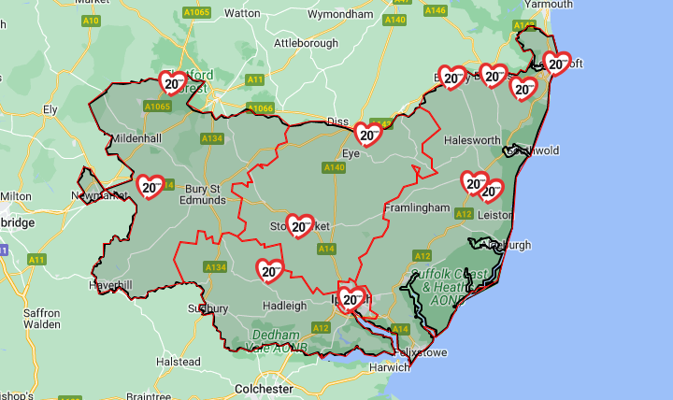
20’s Plenty for Suffolk
15-Feb-23
Adrian Berendt

Slide 2

Agenda
What is 20s Plenty for Us?
Why 20mph?
Lessons from elsewhere
What next?

Slide 3
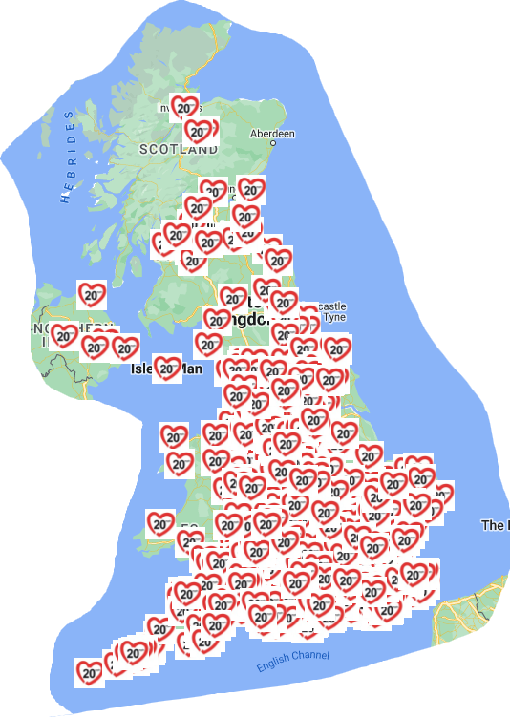
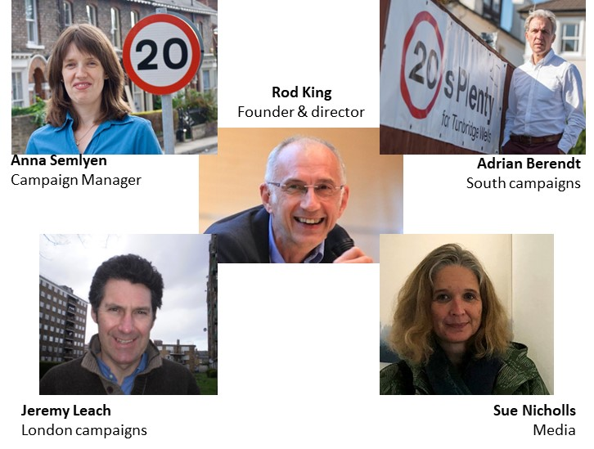
“…20mph where people work, live, shop and play”
20’s Plenty for Us
We support local communities asking for…
>650 campaigns across the UK
26 million people live in places where 20mph is the norm
Notes:
3
Stop Speeding Summit
19th Nov 2010

Slide 4
Agenda
What is 20s Plenty for Us?
Why 20mph?
Lessons from elsewhere
What next?

Slide 5

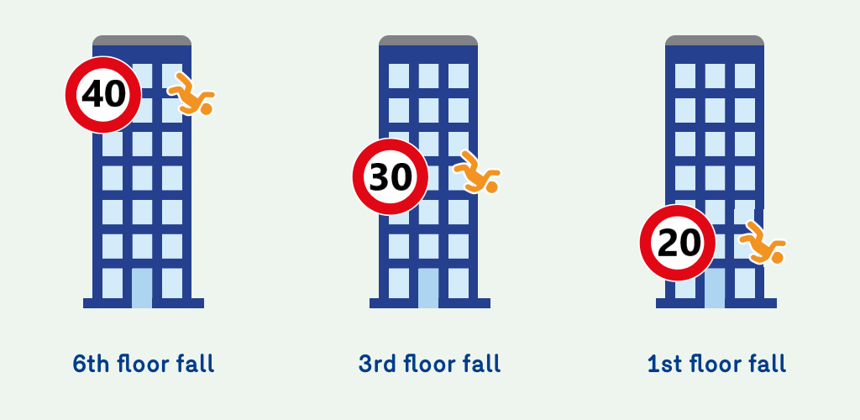
Reduces risk
1mph slower => 6% fewer collisions
30 / 20 mph => c.7x fatality risk for a pedestrian

Slide 6
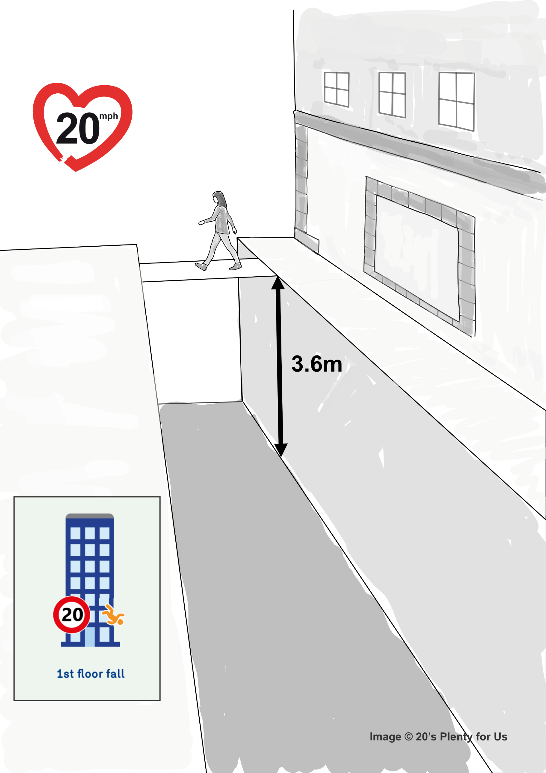
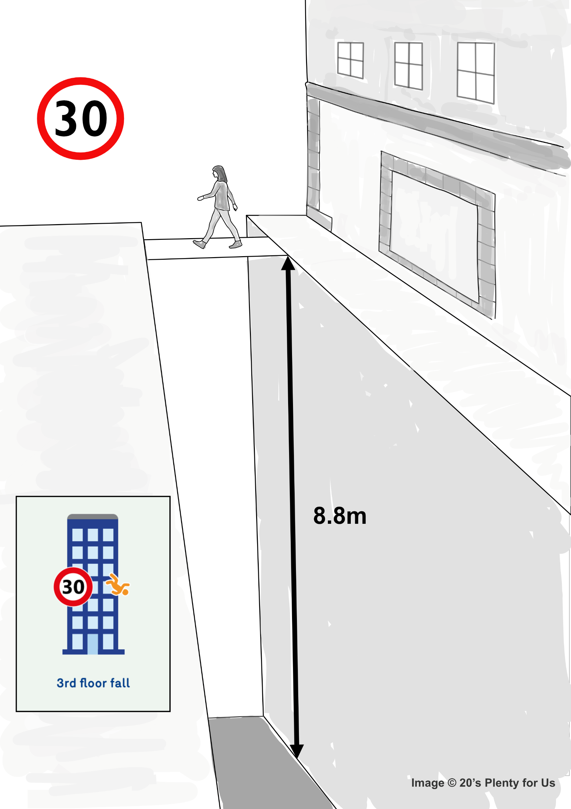
Impact of 20mph vs 30mph
Compare falling into a 3.6m trench (1st floor) vs. 8.8m trench (3rd floor)
=> c.7x fatality risk for a pedestrian
1mph slower => 6% fewer collisions

Slide 7
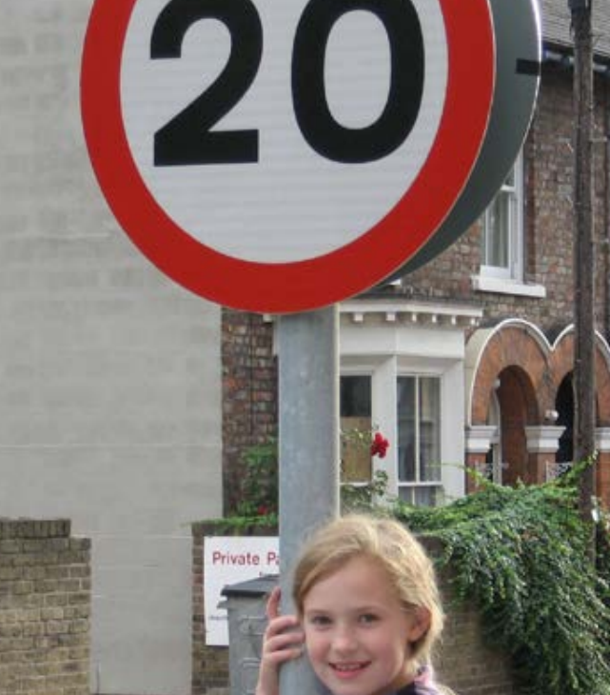
Benefits
Economic
  Better for local business
  20%+ fewer casualties
  Independent mobility for young and old
Social
  Better for health
  More walking and cycling
  People take precedence over motor vehicles
  Stronger communities
Environmental
  Climate-friendly
  Reduces pollution
  Less noise

Slide 8

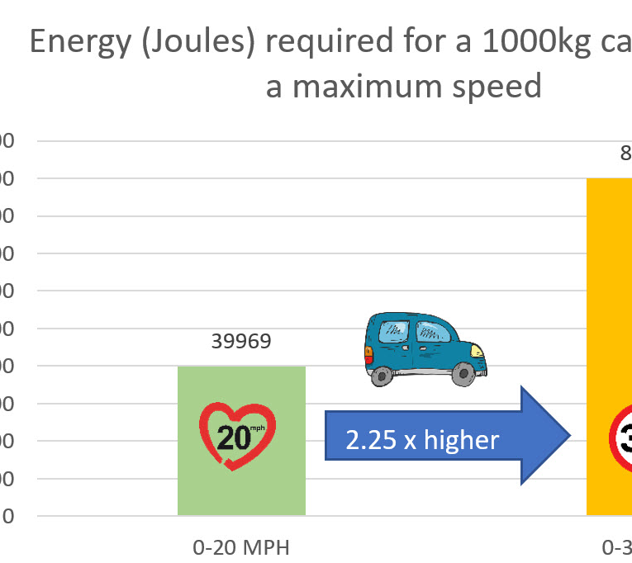
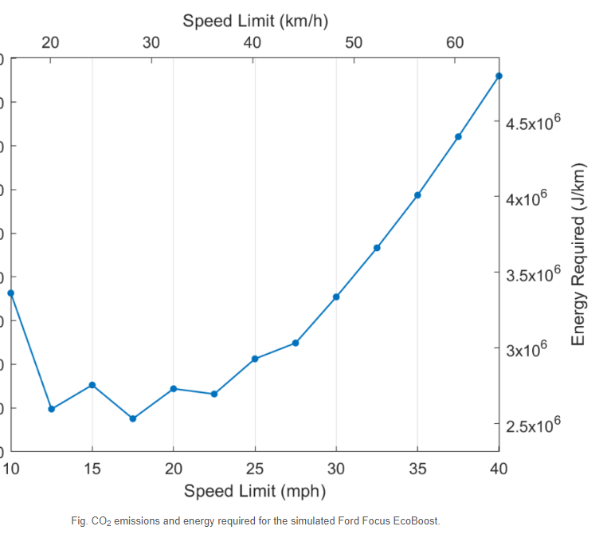
Emissions
C02 / N0x 1/3 higher at @ 30mph
https://futuretransport.info/urban-traffic-research/

Slide 9
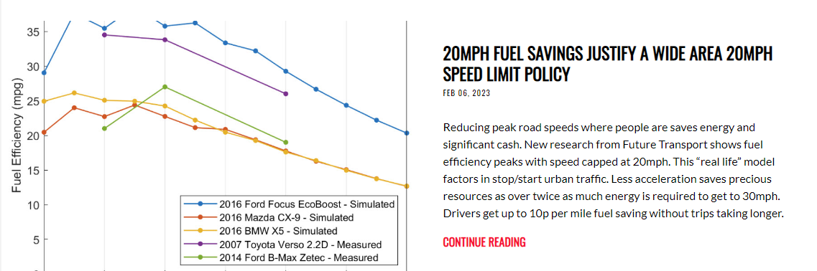
Cost of living crisis: 20mph money-saver
“…10p / mile saving; no change in journey time…”

Slide 10
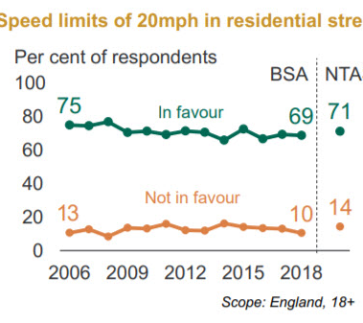
20mph consistently popular

Slide 11
Agenda
What is 20s Plenty for Us?
Why 20mph?
Lessons from elsewhere
What next?

Slide 12


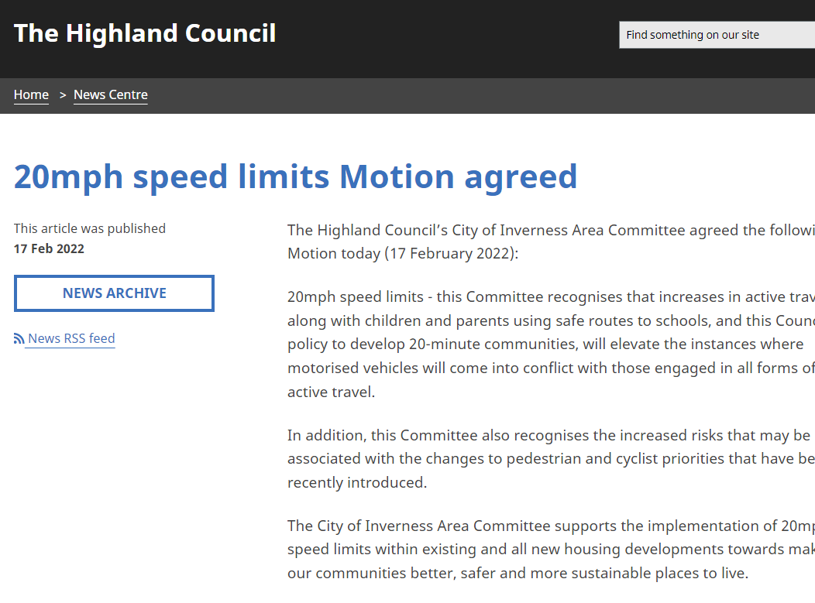
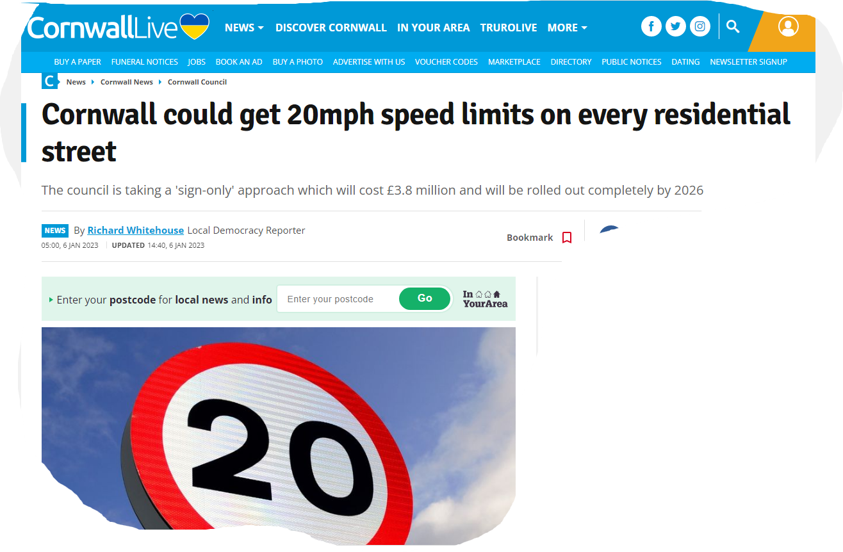
From John O’Groats to Land’s End
Philip Desmond, Cornwall county councillor: “20mph is amazingly popular” https://vimeo.com/763107951

Slide 13
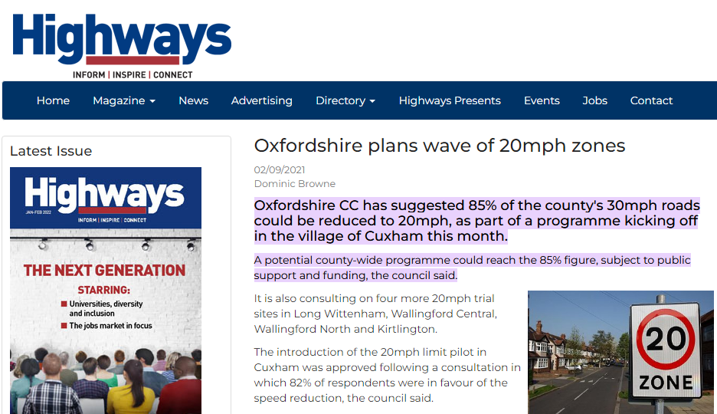
In Oxfordshire 85% of streets to be 20mph

Slide 14

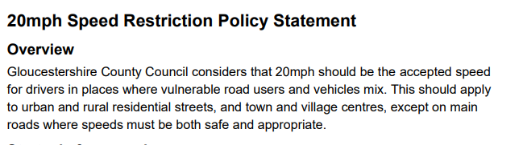
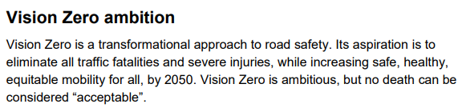
Gloucestershire

Slide 15
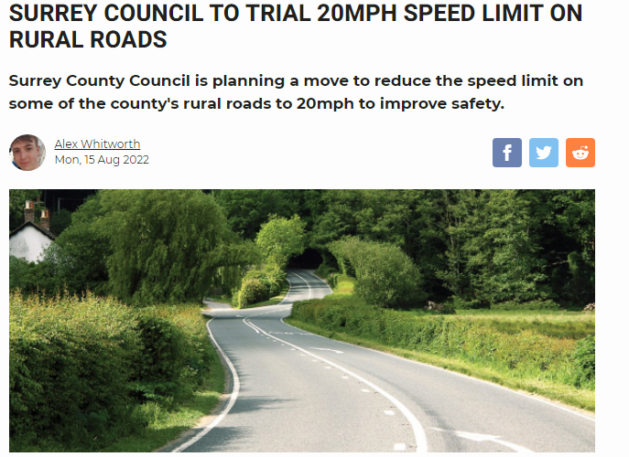
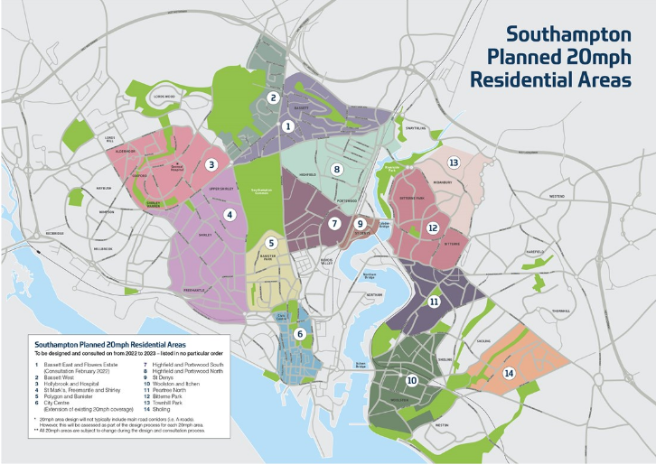
✗

Slide 16

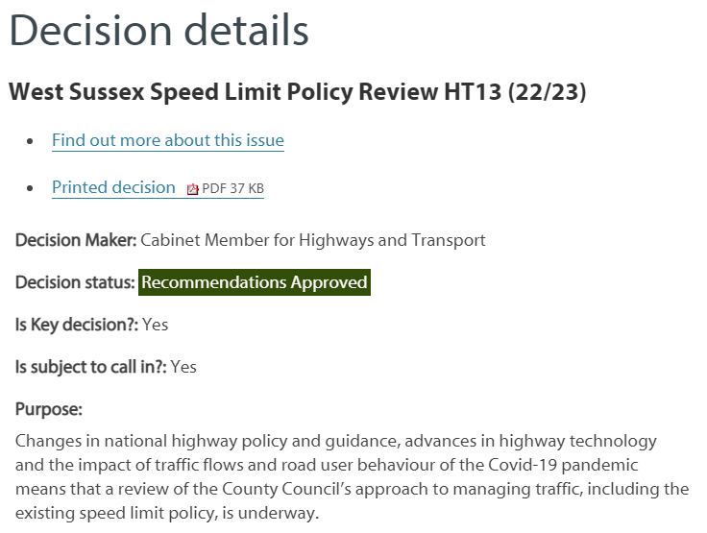
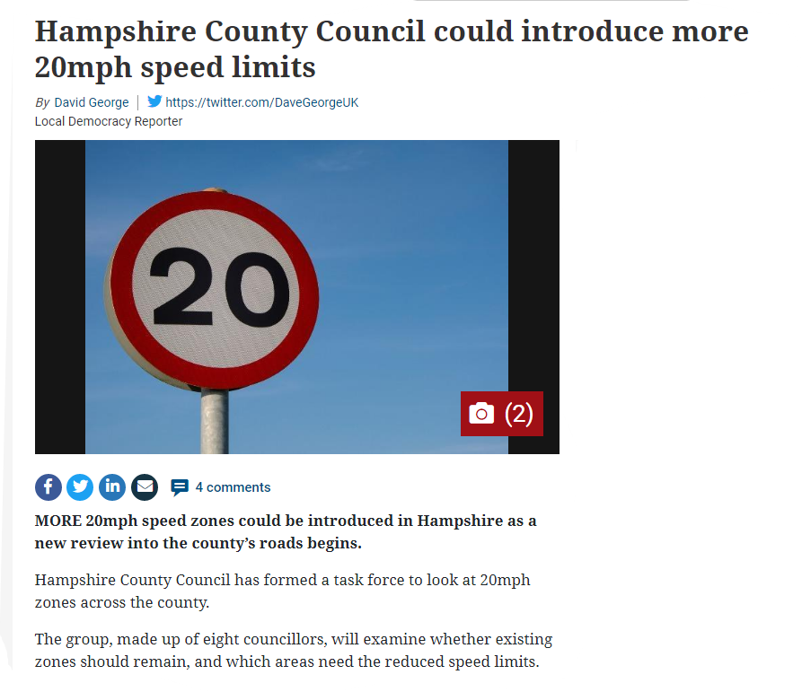


Slide 17

From 17th September 2023
“In Wales:
20mph normal; 30mph an exception”

Slide 18
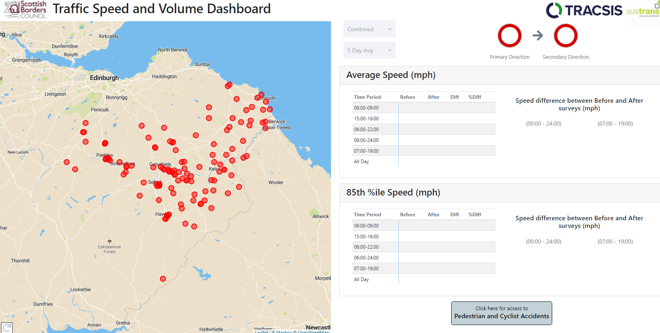

Slide 20
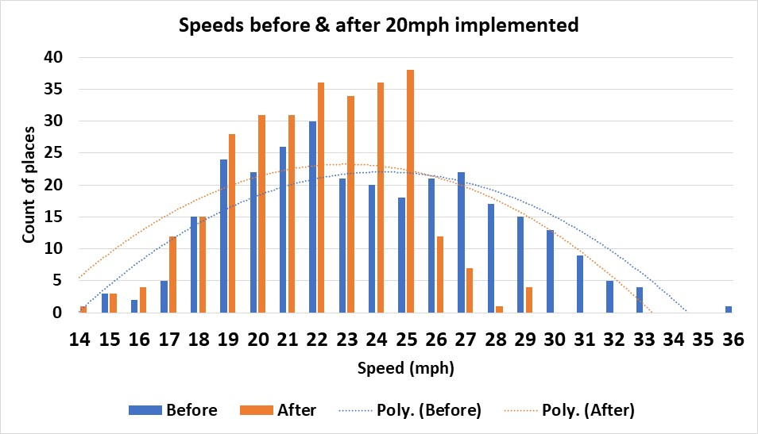

Slide 21

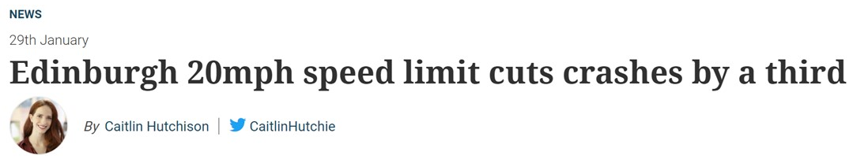
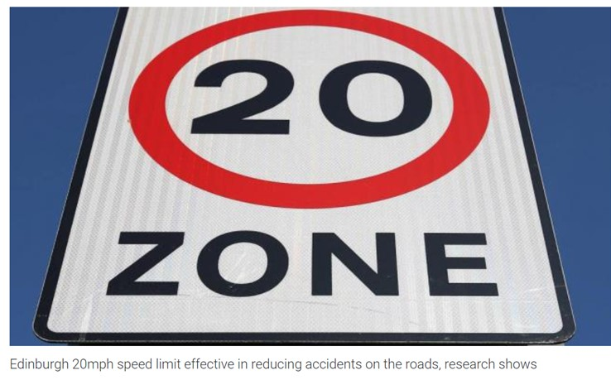
Typically, 20mph means 20% fewer casualties. Edinburgh saw a larger reduction

Slide 22
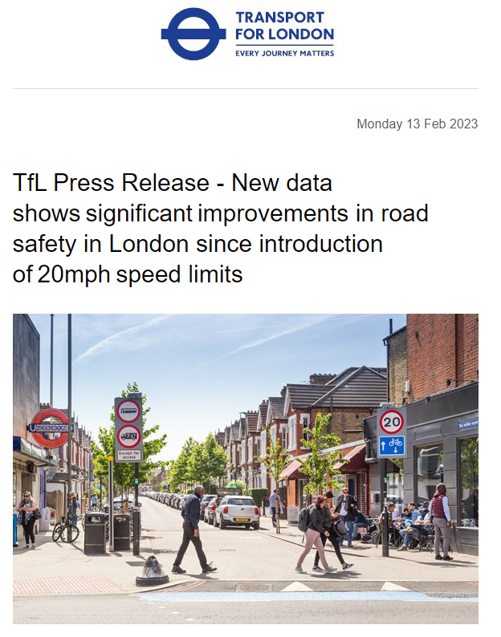
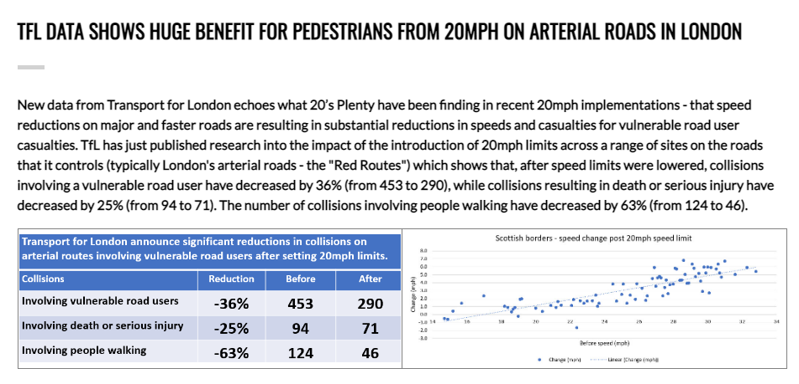
Hot off the press…
https://tfl-newsroom.prgloo.com/news/tfl-press-release-new-data-showssignificantimprovements-in-road-safety-in-london-since-introduction-of20mphspeed-limits

Slide 23
Agenda
What is 20s Plenty for Us?
Why 20mph?
Lessons from elsewhere
What next?

Slide 24
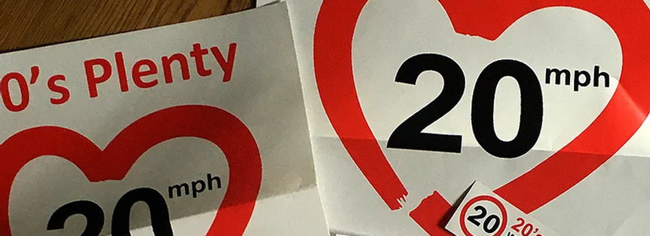
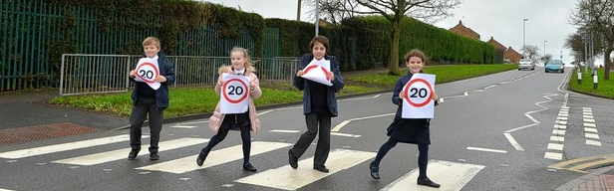



Next Steps – Your views welcome
Suffolk

Slide 25
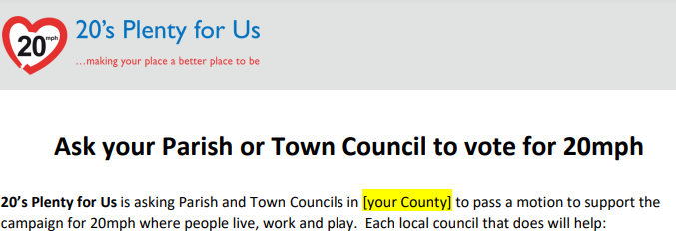
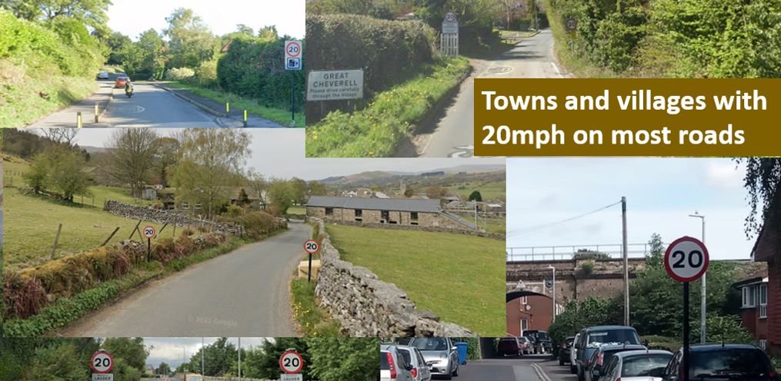
Next steps
1. Form a local campaign
2. Pass a 20mph motion
3. Ask SCC to make 20mph the default

Slide 26
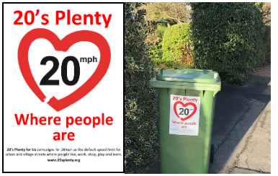
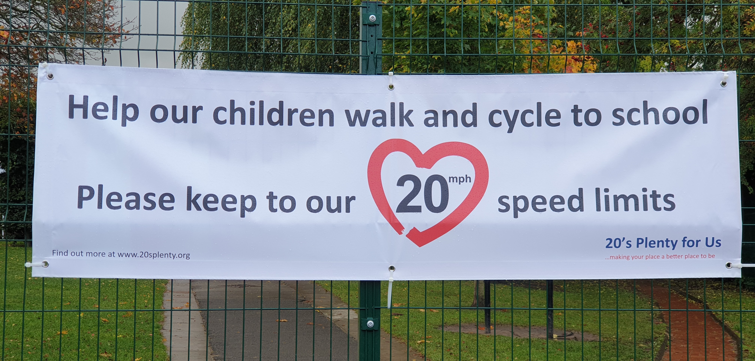
And… 4: buy resources to support

